Slide 1
Lesson 8: HTML/Javascript Fund Me
Reference: Patrick Collins

Slide 2
Introduction
In order for web3 to be approachable to the masses, we need to have user-friendly frontends and websites. There are a few challenges that full stack software engineers run into when approaching this problem in the blockchain space.
How do I connect Metamask to my UI? (Or Walletconnect, Phantom, etc.)
How do I execute a transaction with my smart contract from a website?
What are the tools the best of the best are doing?
So, in asking myself this problem and trying to figure out what to recommend to developers, I ended up looking at nearly ALL the most popular solutions. So in this article, we are going to:
Understand what is going on in the browser when we want to interact with or send a transaction to a blockchain.
We look at six of the most popular methods to connect to our web3 applications
Give code examples and show what all the biggest players in the space use, so you can use the same tools!
If you’d like to see what some professional frontends look like right now, you can take a look at the Aave or Uniswap website.

Slide 3
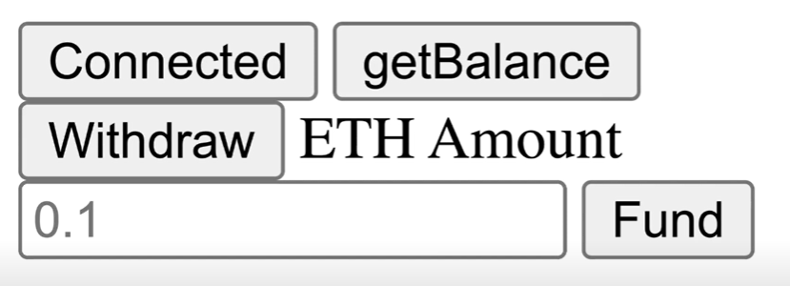
Connecting HTML to Metamask

Slide 4
Sending a transaction from a Website
With a recent update (Mobile v5.3.0), we added a feature that allows you to add one of several popular networks without having to input any details.
You can find this menu using the following steps:
Tap the hamburger icon in the top-left of the screen.
Go to 'Settings', and then to 'Networks'.
Tap the 'Add Network' button at the bottom of the screen.
You should now see a list of networks you can add under the 'Popular' tab. Tap one and follow the prompts to add it to MetaMask. All done!
This feature will also be added to Extension soon.

Slide 5
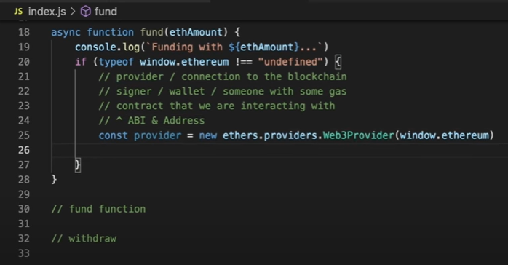
Sending a transaction from a Website

Slide 6
Resetting an Account in Metamask
MetaMask - RPC Error:
[ethjs-query] while formatting ouputs from RPC '{"value":{"code":-32603,"data":{"code":-32000,"message":"Nonce too high. Expected nonce to be 2 but got 4. Note that transactions can't be queued when automining."}}}'

Slide 7
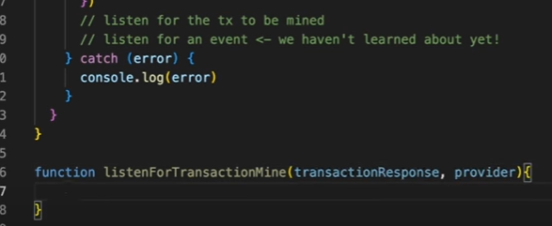
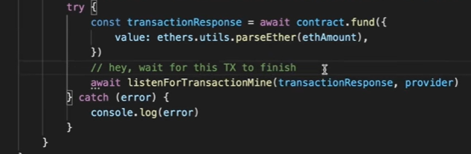
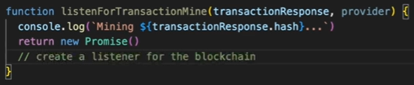
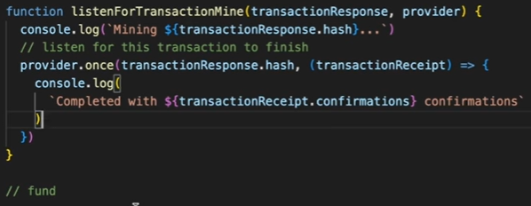
Listening for Events and Completed Transactions
→
↓

